Slide 1
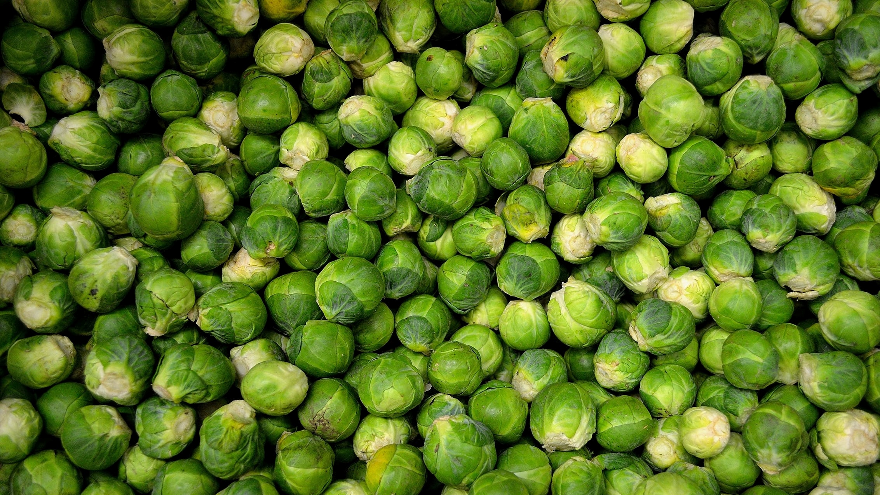

SITE TEMPLATES, SITE LIFE CYCLE MANAGEMENT AND MODERN SHAREPOINT
#SPSBE
Albert-Jan Schot| @appieschot
SharePoint Saturday Belgium 2019

Slide 3

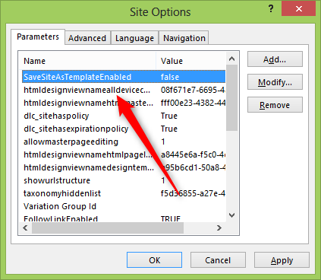
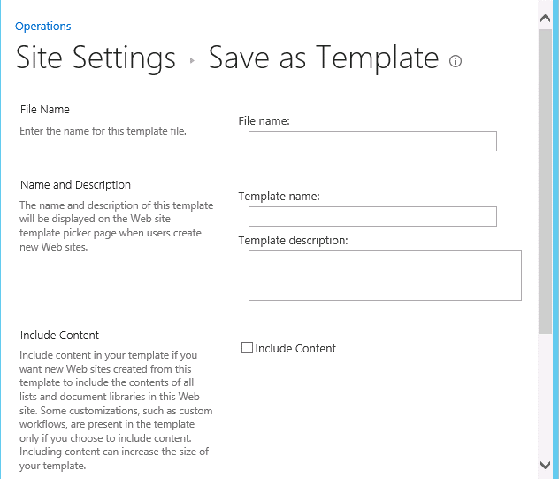
Save site as template

Slide 4
SITE LIFE CYCLE MANAGEMENT

Slide 5
Site life cycle management
User need

Slide 6
Site life cycle management
User need
Business Logic & approval

Slide 7
Site life cycle management
User need
Business Logic & approval
Apply template

Slide 8
Site life cycle management
User need
Business Logic & approval
Apply template
Apply governance

Slide 9
Site life cycle management
User need
Business Logic & approval
Apply template
Apply governance
Update site

Slide 10
Site life cycle management
User need
Business Logic & approval
Apply template
Apply governance
Update site

Slide 11
Site life cycle management
User need
Business Logic & approval
Apply template
Apply governance
Update site
Flow / Logic Apps
PowerApps
LOB apps
Site Designs
PnP
3th party apps

Slide 12
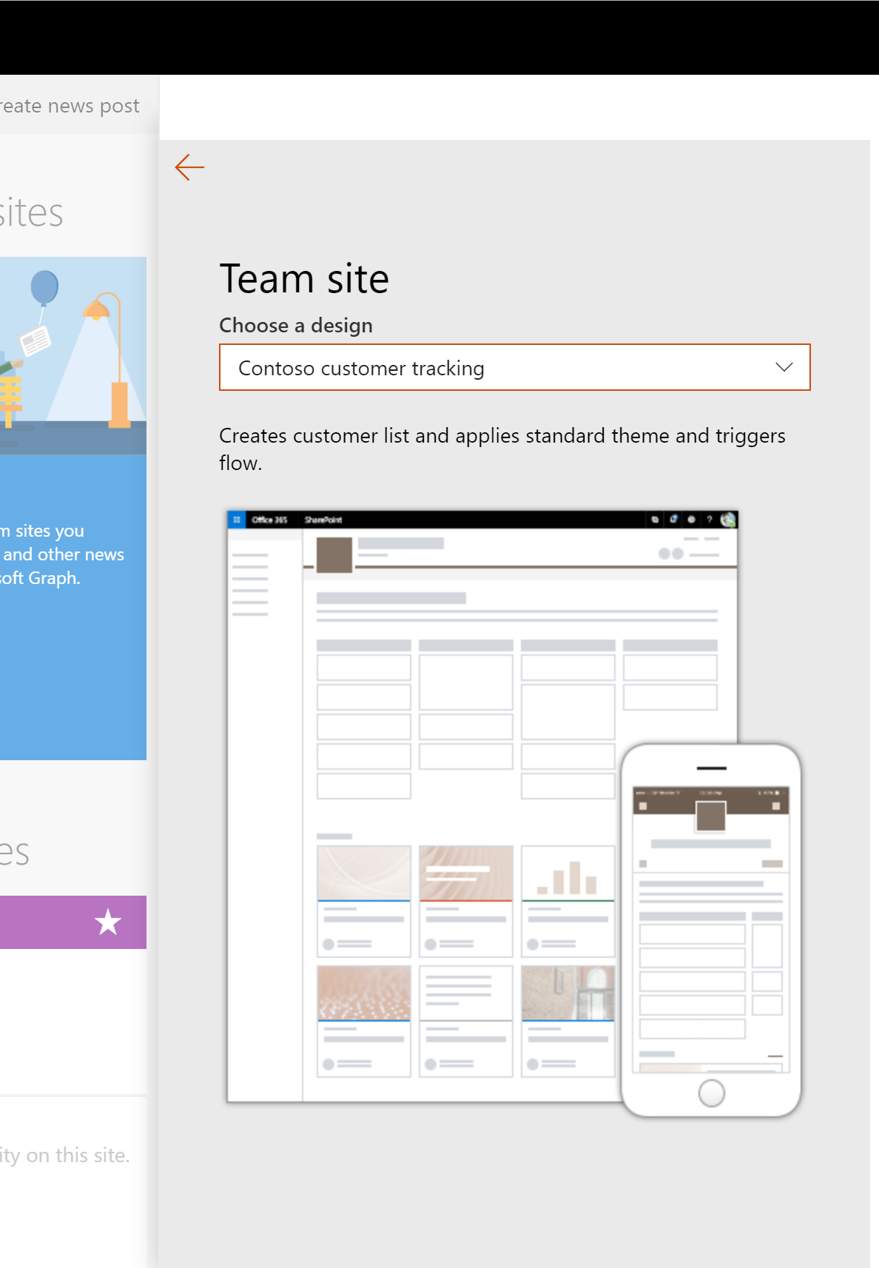
Site designs 101
A set of predefined actions executed after a site has been created.
Each site design consists of one or multiple site scripts
Each tenant can hold up to 100 site designs and site scripts
Each site script can hold up to 300 actions, or 100,000 characters
Executing the same actions multiples times should be non-destructive

Slide 13
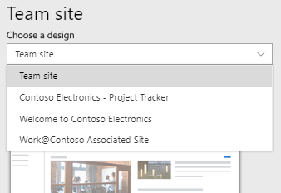
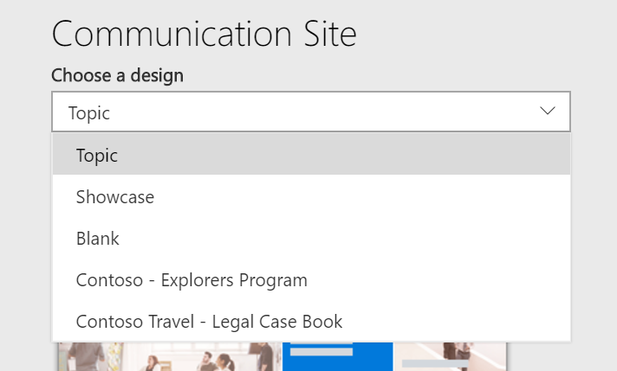
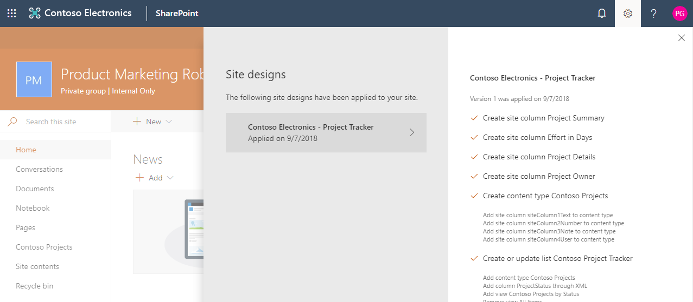
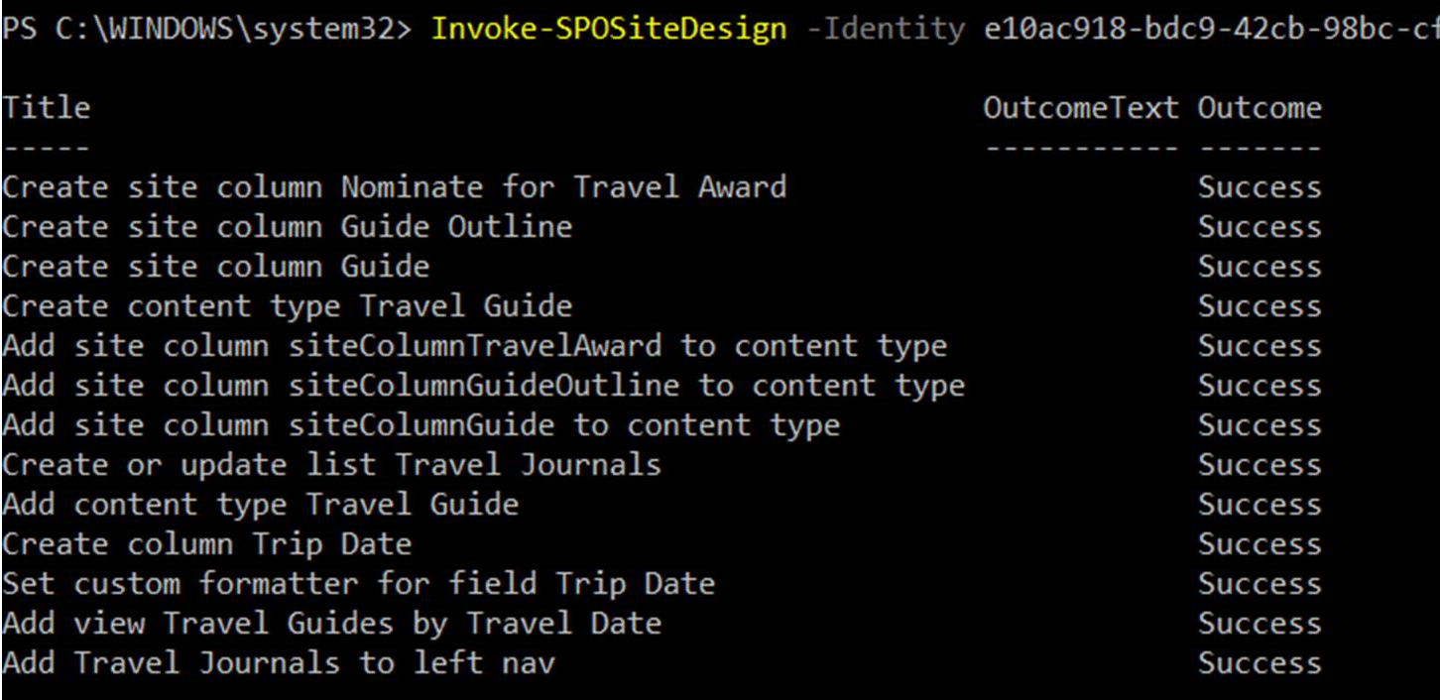
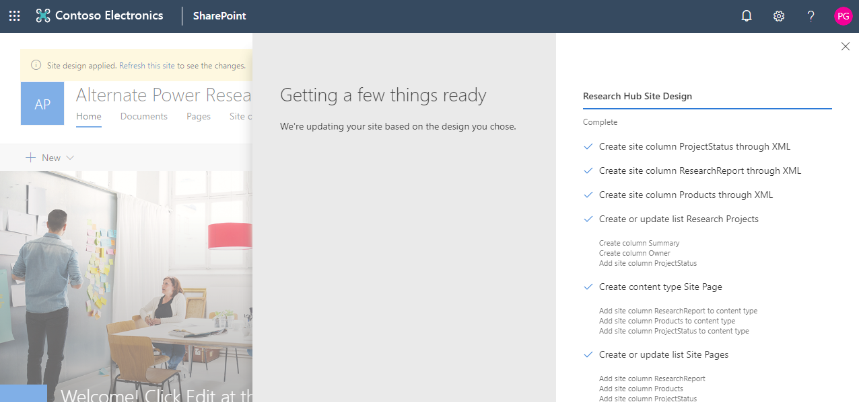
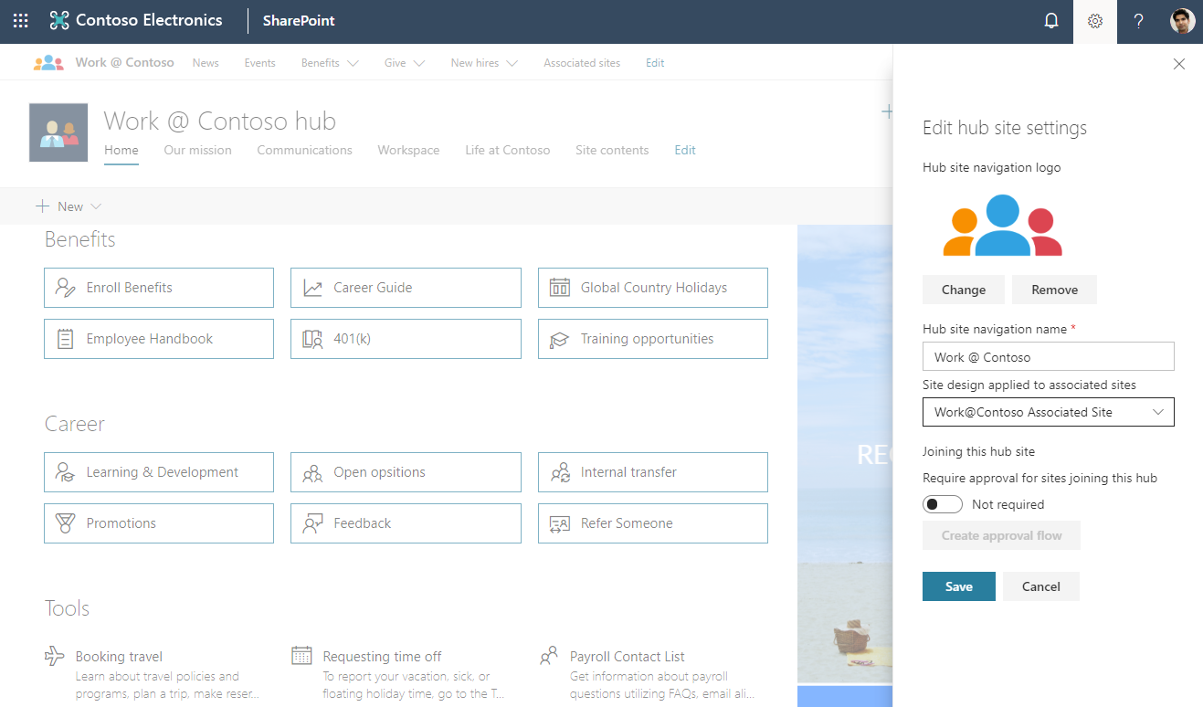
Site design infrastructure
Site Scripts
Title
ID
Script actions (Create List, Apply Theme, Add to Nav, Trigger Flow…)
Site Designs
Title & Desc
Preview Image
Web Template
Site Script Array
Scope | isDefault
CREATION
APPLICATION
USE & REUSE

Slide 14



Site script actions
Apps & Solutions
Branding & Other Site Settings
SharePoint Components
Settings
addPrincipalToSPGroup
addNavLink (QL, Hub, footer)
removeNavLink (QL, Hub, footer)
applyTheme
setSiteLogo
setSiteBranding
Header layout
Header background
Navigation Style
Footer visibility
setRegionalSettings
setSiteExternalSharingCapability
triggerFlow
joinHubSite
activateSPFeature
SharePoint Components
createSPList
addSPField
deleteSPField
addSPFieldXml
createSiteColumn
createSiteColumnXml
Global Taxonomy
addSiteColumn
addContentType
createContentType
removeContentType
addSPView
removeSPView
setSPFieldCustomFormatter
Register Solutions:
installSolution
SPFx Extension support!
associateExtension
associateListViewCommandSet
associateFieldCustomizer
JSON Schema: https://docs.microsoft.com/en-us/sharepoint/dev/declarative-customization/site-design-json-schema

Slide 15
Site designs and site scripts

Slide 16
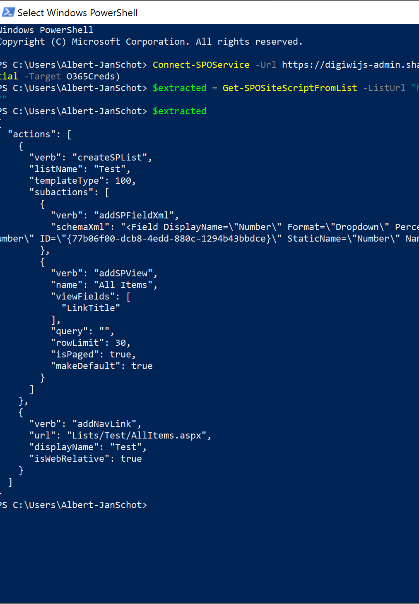
Site scripts auto-generation
New option to generate site script using PowerShell
Get-SPOSiteScriptFromWeb
-WebURL
-IncludeTheming
-IncludeBranding
-IncludeSiteExternalSharingCapability
-IncludeRegionalSettings
-IncludeLists "ListUrl“

Slide 17
Site designs and Flow
User creates a site
Site design gets applied

Slide 18
Site designs and Flow
User creates a site
Site design gets applied
Design Triggers Flow

Slide 19
Site designs and Flow
User creates a site
Site design gets applied
Design Triggers Flow
Flow writes to queue

Slide 20
Site designs and Flow
User creates a site
Site design gets applied
Design Triggers Flow
Flow writes to queue
Azure Function triggers

Slide 21
Site designs and Flow
User creates a site
Site design gets applied
Design Triggers Flow
Flow writes to queue
Azure Function triggers
PnP Gets applied

Slide 22
Site designs and Flow

Slide 23


Flow & Logic Apps
HttpTriggers are a premium connector in Flow
You can call a Logic App as well

Slide 24
Site designs and Flow
User creates a site
Site design gets applied
Design Triggers Flow
Flow writes to queue
Azure Function triggers
PnP Gets applied

Slide 25
Site designs and Logic Apps

Slide 26

Site lifecycle management
Site Designs can be reapplied
PnP supports for updating of existing sites
Define only your update actions in your template
Use Flow for update your sites
Archive or update sites according to your business needs

Slide 27
What’s next
Find your resources at https://aka.ms/sppnp & https://aka.ms/spsitedesigns & https://aka.ms/spsitescriptsamples https://github.com/SharePoint/sp-dev-solutions/tree/master/solutions/SiteDesignsStudio
Start coding
Provide feedback: https://github.com/SharePoint/PnP-Sites-Core and https://sharepoint.uservoice.com/forums/329214-sites-and-collaboration?category_id=144408

Slide 28

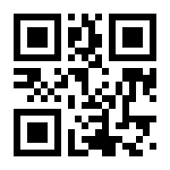
http://spsbe.be
#SPSBE
Please rate this session!

Slide 29

#SPSBE
SharePoint Saturday Belgium 2019

